Slide 1
FPGA Basic Architecture
By Dr. Min He

Slide 2
Outline
FPGA Architecture
CLB – Configurable Logic Blocks
Function Generators
Implementing Combinational Logic
Implementing Sequential circuits
Xilinx FPGA Basic Resources
Role of a bitstream

Slide 3
FPGA Architecture
A field programmable gate array (FPGA) is an array of logic gates in which the connections can be configured by downloading a bitstream into its memory.
A modern FPGA consists of
CLBs: an array of configurable logic blocks
I/O pads: Along the perimeter of the FPGA are special logic blocks connected to external package I/O pins
Routing channels: routing resources implemented in CMOS technology
Notes:
From http://en.wikipedia.org/wiki/Field-programmable_gate_array.
“Embedded System Design with Platform FPGAs Principles and Practice”, by Ron Sass and Andrew G. Schmidt.

Slide 4
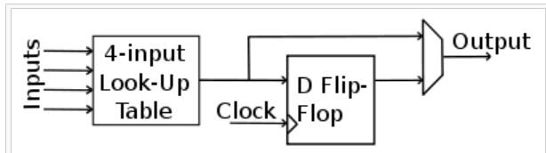
CLB – Configurable Logic Block
Logic blocks consist of multiple logic cells, while logic cells contain function generators and storage elements.
Ex: A classic FPGA logic block consists of a 4-input lookup table (LUT), and a flip-flop, as shown below.

Slide 5
Function Generators
FPGA devices use function generators to implement Boolean logic functionality rather than physical gates.
Ex: f(x,y,z) = xy + z’ can be implemented Using a 3-input function generator
Create the 8-line truth table
Each of the function’s output bit is stored into an individual static memory(SRAM) cell and connected as information inputs to an 8-to-1 MUX.
The 3 inputs will be the select lines for the MUX
The result is commonly known as a look-up table (LUT):
The propagation delay from a LUT is fixed;
Multiple MUX can be used to implement functions with more inputs.
Notes:
An important observation is that SRAM cells are volatile. Thus after power cycle the board, we need to reconfiguring or re-programming the FPGA.

Slide 6
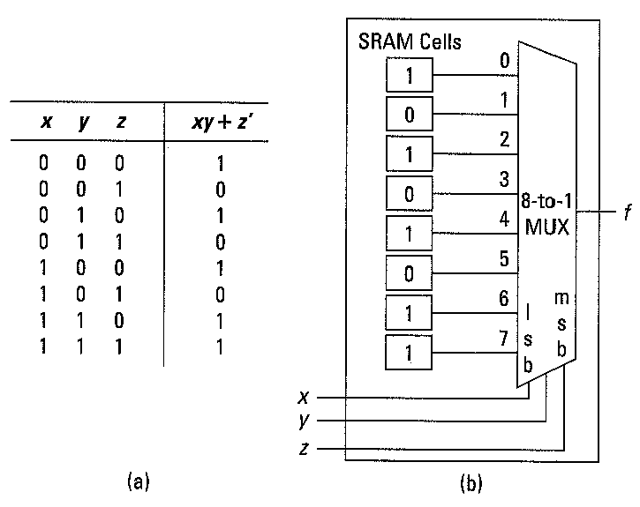
Example: LUT for f(x,y,z) = xy + z’

Slide 7
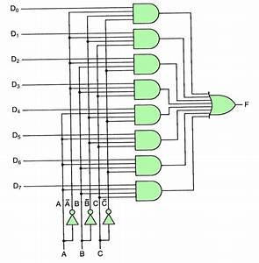
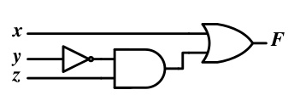
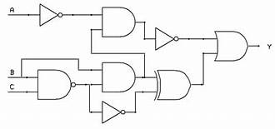
Comparing FPGA implementation and Gate Level Implementation

Slide 8
Combinatorial logic
Boolean logic is stored in Look-Up Tables (LUTs)
Also called Function Generators (FGs)
Capacity is limited by the number of inputs, not by the complexity
Delay through the LUT is constant
A | B | C | D | Z
0 | 0 | 0 | 0 | 0
0 | 0 | 0 | 1 | 0
0 | 0 | 1 | 0 | 0
0 | 0 | 1 | 1 | 1
0 | 1 | 0 | 0 | 1
0 | 1 | 0 | 1 | 1
 | . | . | .
1 | 1 | 0 | 0 | 0
1 | 1 | 0 | 1 | 0
1 | 1 | 1 | 0 | 0
1 | 1 | 1 | 1 | 1
Combinatorial Logic
A
B
Z
C
D

Slide 9
Sequential circuits and Storage Elements
While function generators provide the fundamental building blocks for combinational circuits, a D flip-flop is connected to the output of function generator to provide data storage.
A Logic Cell is the combination of a look-up table and a D flip-flop. It is the low-level building block upon which FPGA designs are built.
Many FPGA vendors compare the capacity of an FPGA based on the number of logic cells (along with other resources as well).
Notes:
It is no longer revelant to describe an FPGA circuit in terms of “number of equivalent gates (or transistors)” This is because a single LUT can represent very modest equations, which would only require a few transistors to implement, or a very complex circuit such as RAM, which would require many hundreds of transistors.

Slide 10
Xilinx FPGAs Basic Resources
Logic Resources
Slices (grouped into CLBs)
Contain combinatorial logic and register resources
Memory
Multipliers
Interconnect Resources
Programmable interconnect
IOBs
Interface between the FPGA and the outside world
Other resources
Global clock buffers
Boundary scan logic

Slide 11
Role of a Bitstream
To program configuration memory, instructions for the configuration control logic and data for the configuration memory are provided in the form of a bitstream.
The bitstream is delivered to the device through one of the JTAG, SelectMAP, or Serial configuration interfaces.

Slide 12
Reference and Reading Materials
FPGA architecture: “Embedded System Design with Platform FPGAs Principles and Practice”, by Ron Sass and Andrew G. Schmidt.

